Slide 1
CS4345 Assignment 03 AWS
Name: Dom Arishi
School ID: 915604744

Slide 2
Tutorials I have selected for Q 01
# | AWS Category | Implemented
1 | Acct Management | Control your AWS Costs
2 | Analytics | Create business intelligence dashboards
3 | Compute | Create object storage buckets in Amazon Lightsail
4 | Databases | Create and Query a NoSQL Table with Amazon DynamoDB
5 | DevOps | Remotely Run Commands on an EC2 Instance
6 | Storage | Store and Retrieve a File with Amazon S3
7 | End User | Amazon WorkSpaces Cost Optimizer
8 | Front-End | Host a Static Website
9 | Machine Learning | Extract text and structured data with Amazon Textract
10 | Serverless | Schedule a Serverless Workflow

Slide 3
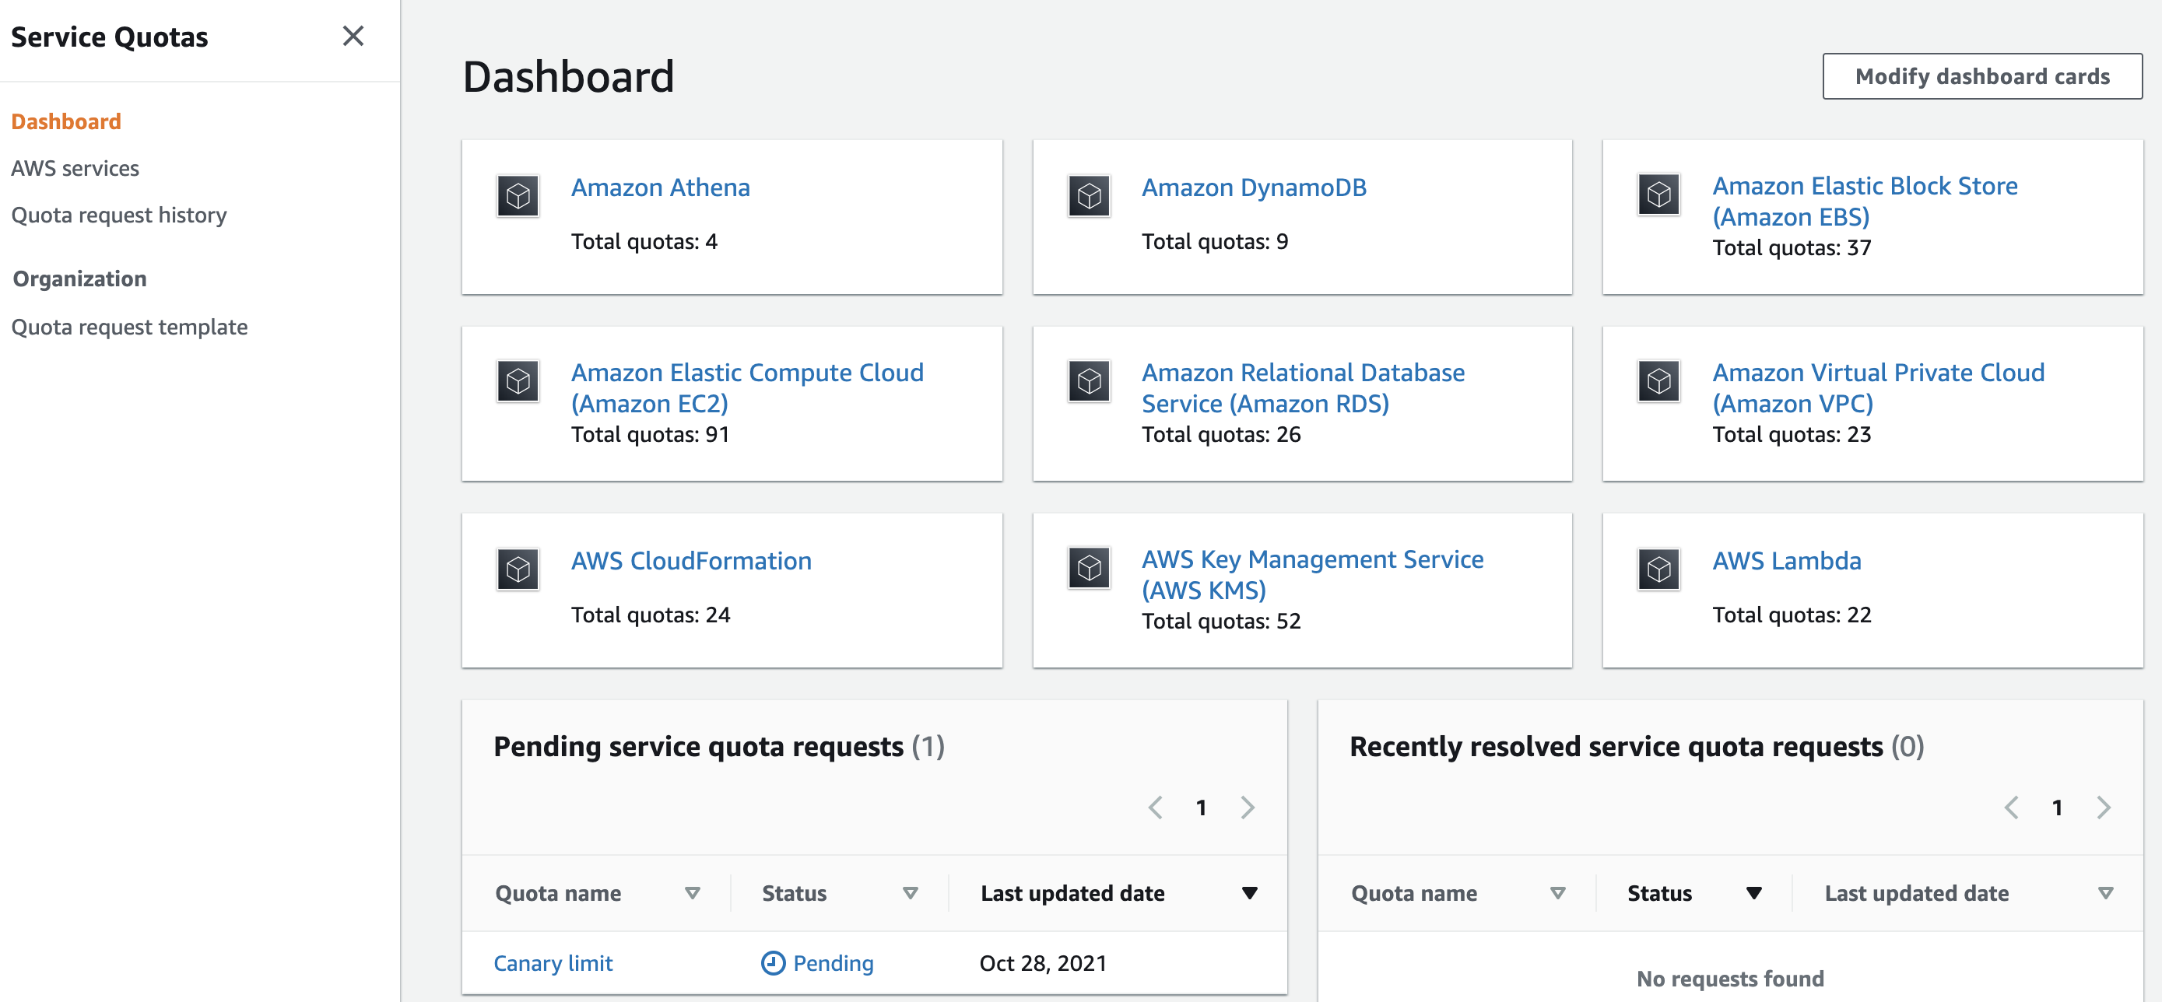
One Screenshot for Tutorial # 01 from Category “Account Management”

Slide 4
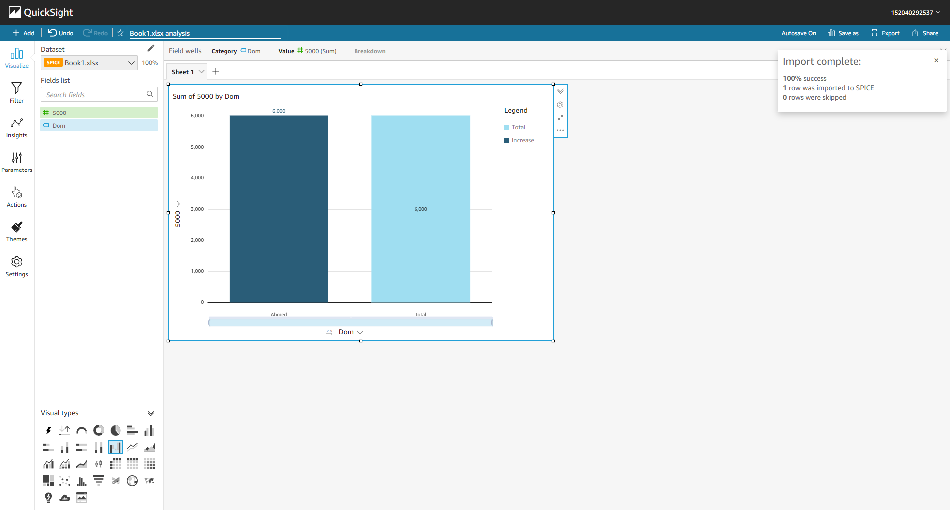
One Screenshot for Tutorial # 02 from Category “Analytics”

Slide 5
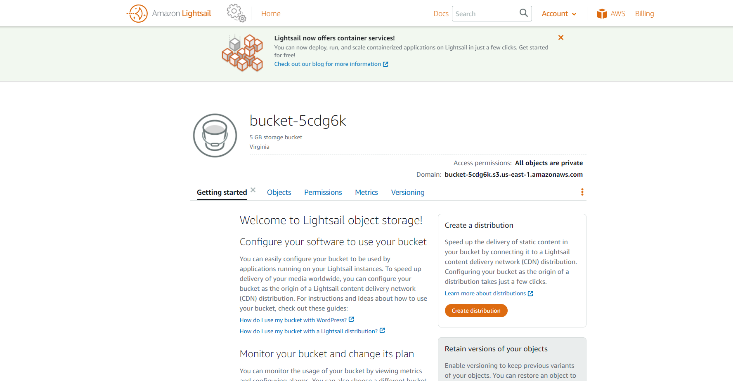
One Screenshot for Tutorial # 03 from Category “Compute”

Slide 6
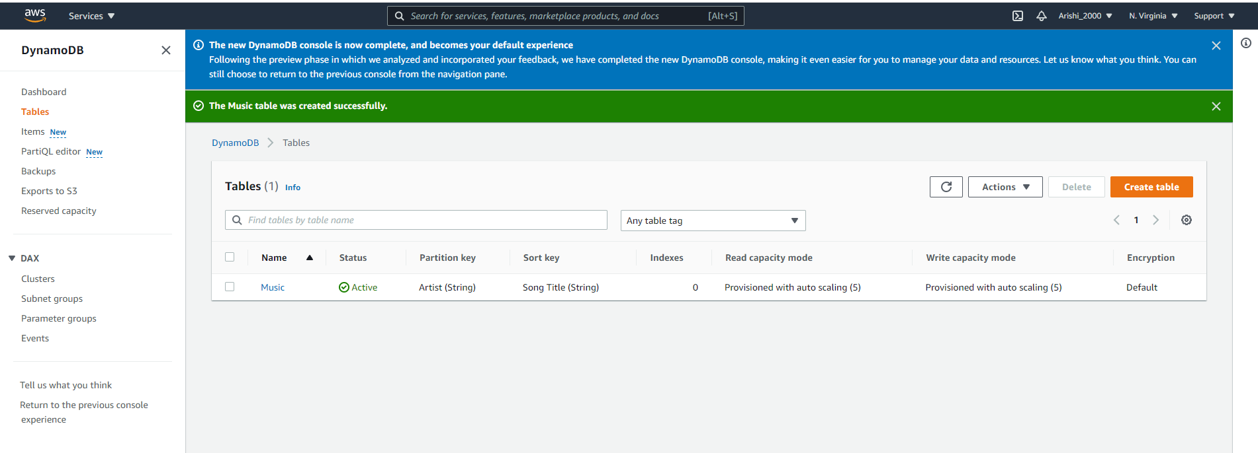
One Screenshot for Tutorial # 04 from Category “Databases”

Slide 7
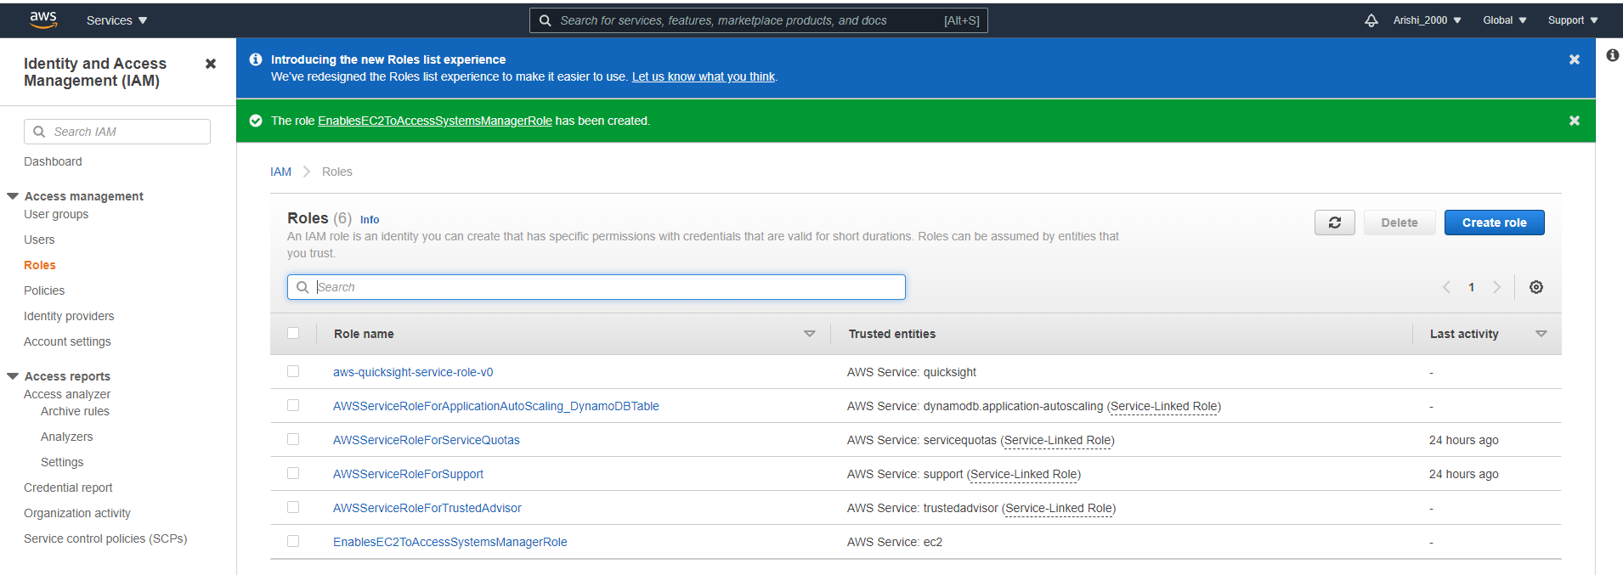
One Screenshot for Tutorial # 05 from Category “DevOps”

Slide 8
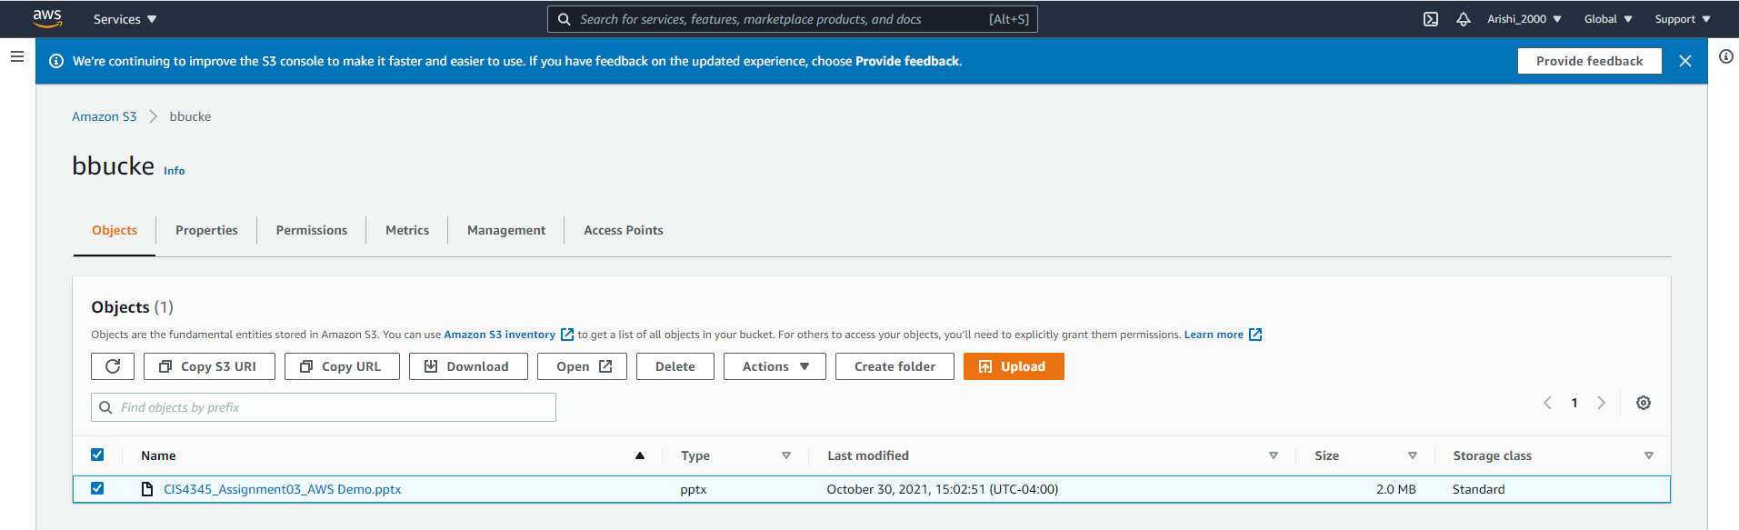
One Screenshot for Tutorial # 06 from Category “Storage”

Slide 9
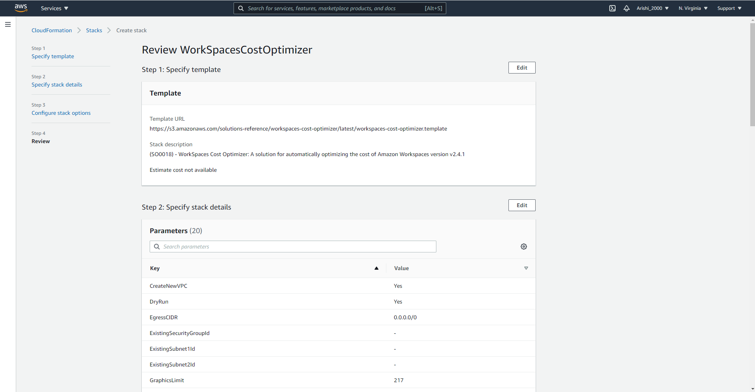
One Screenshot for Tutorial # 07 from Category “Back-End”

Slide 10
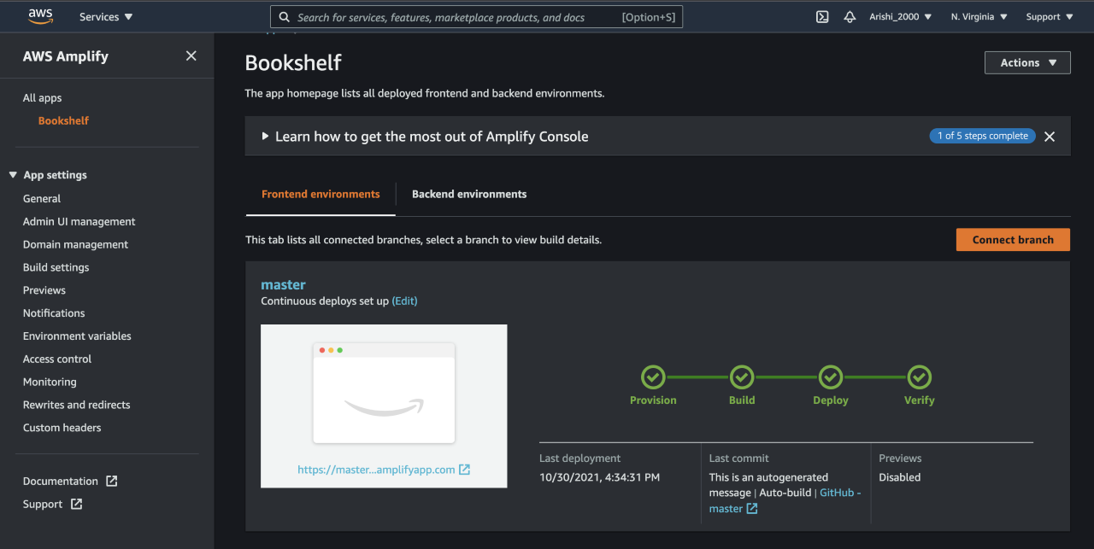
One Screenshot for Tutorial # 08 from Category “Front-End”

Slide 11
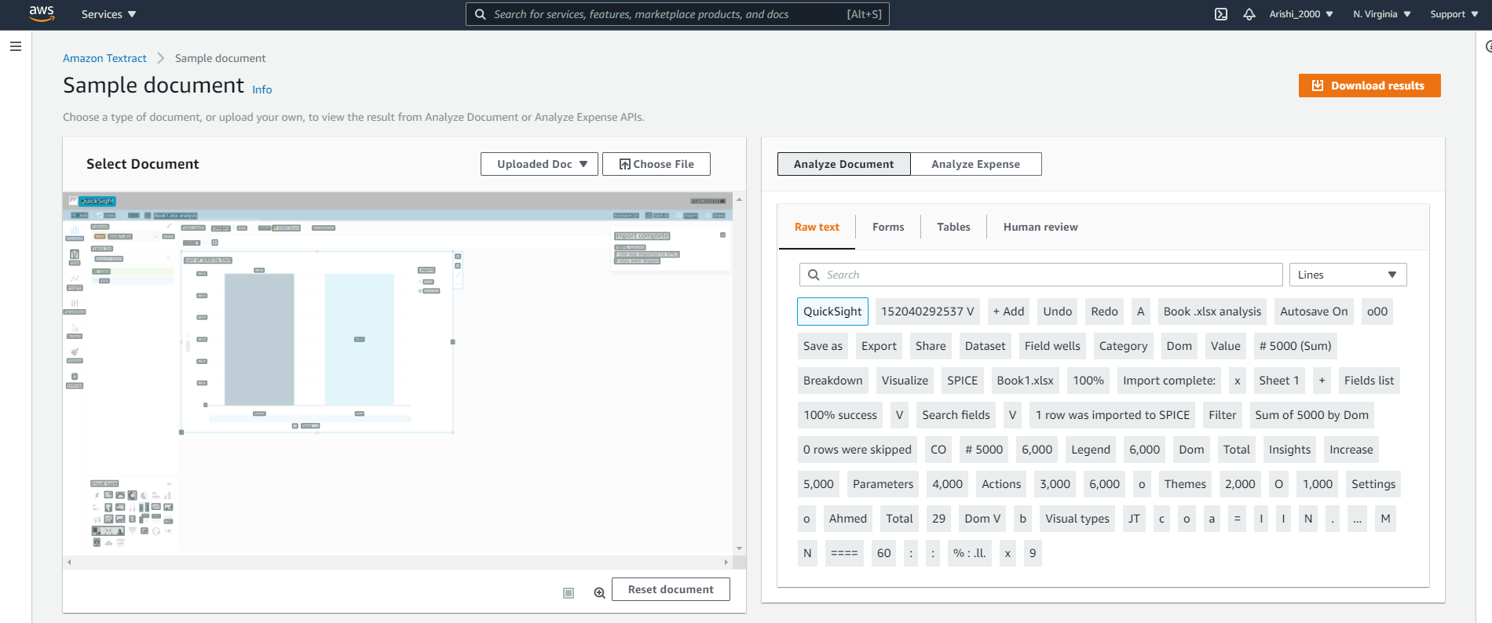
One Screenshot for Tutorial # 09 from Category “Machine Learning”

Slide 12
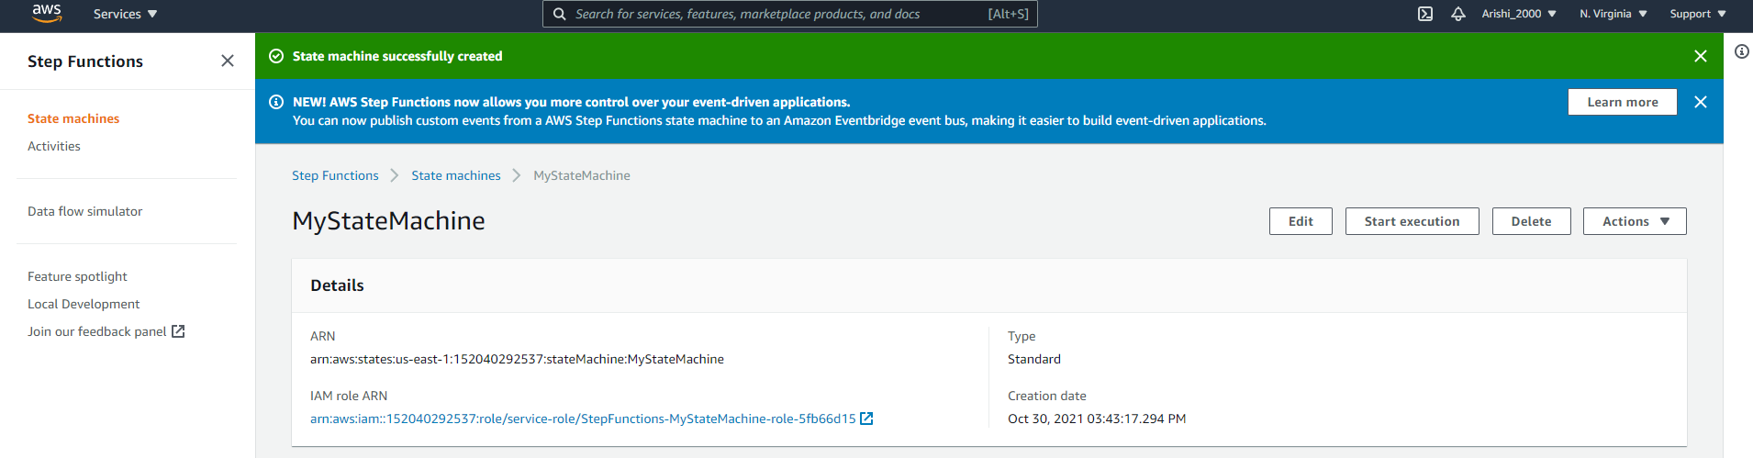
One Screenshot for Tutorial # 10 from Category “Serverless”

Slide 13
Services you’ve used for Q 02
# | AWS Category | Implemented
1 | Machine Learning | Detector
2 | Storage | S3 bucket
3 | Machine Learning | Entity
4 | Machine Learning | Models
5 | Machine Learning | Events
6 | Machine Learning | Variables / Labels
7
8
9
10

Slide 14
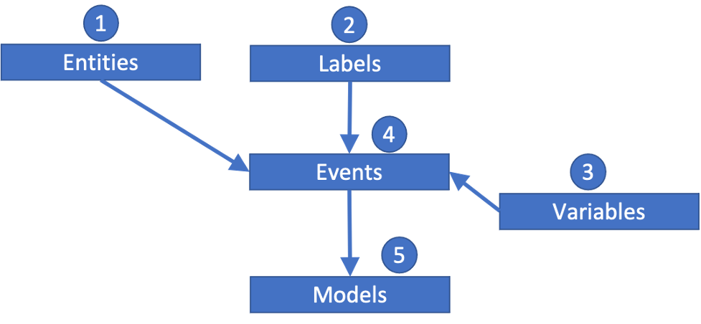
Your Completed Project Flowchart for Q 02
→ The arrows represent connections between service

Slide 15
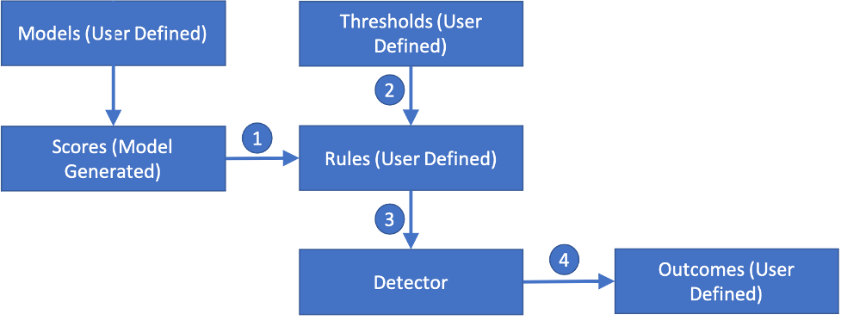
More Detailed flowchart for Q 02

Slide 16
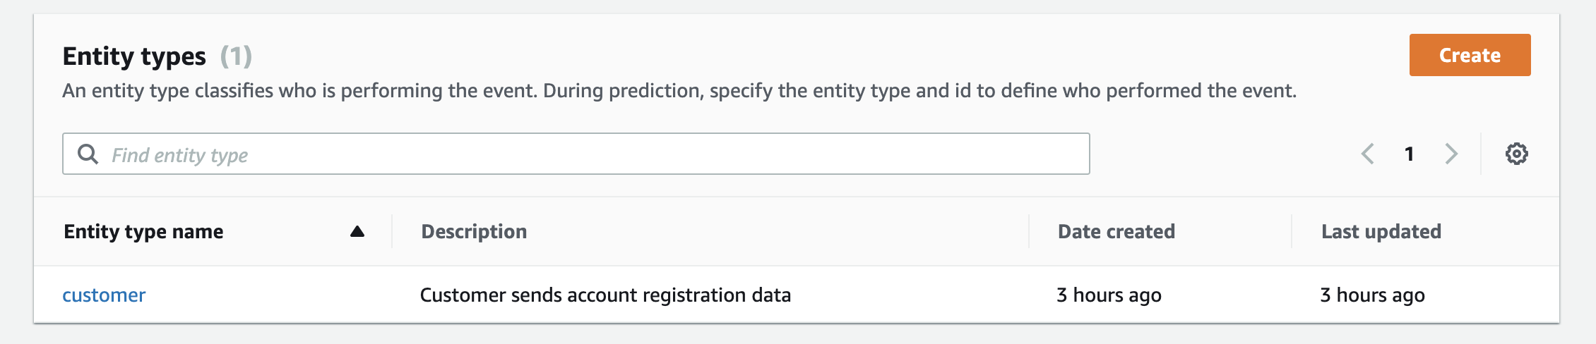
#1 Entity

Slide 17
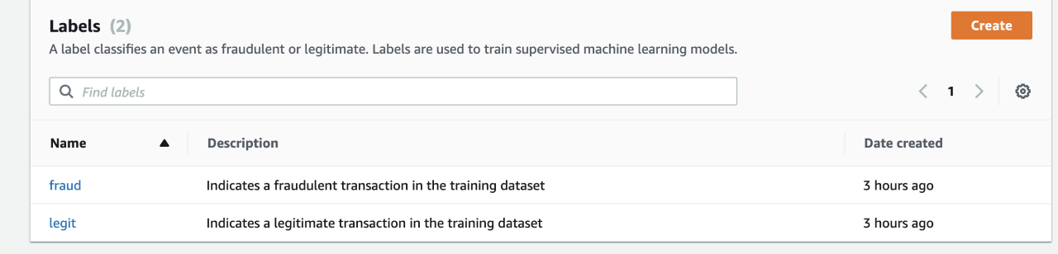
#2 Lables

Slide 18
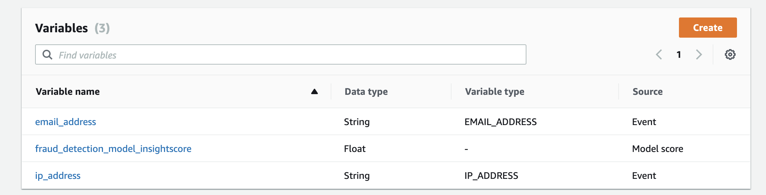
#3 Variables

Slide 19
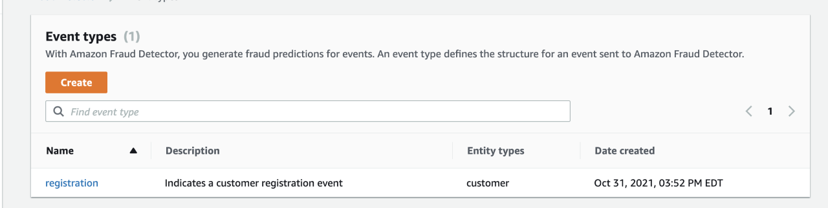
#4 Events

Slide 20
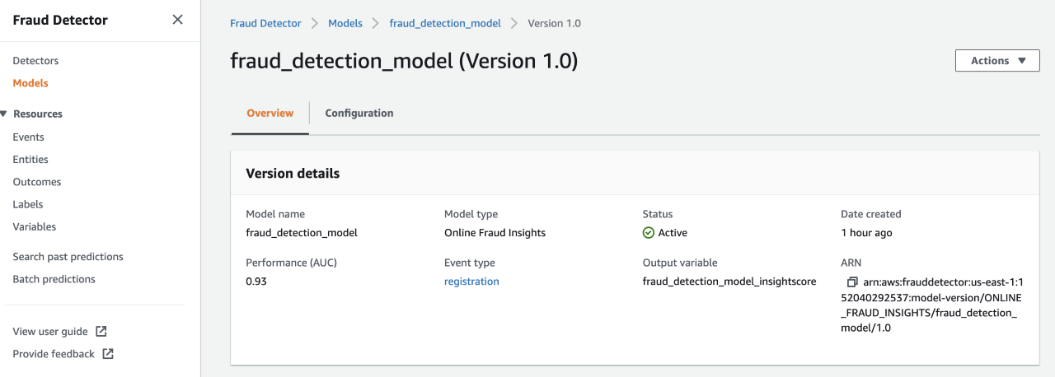
#5 Models

Slide 21
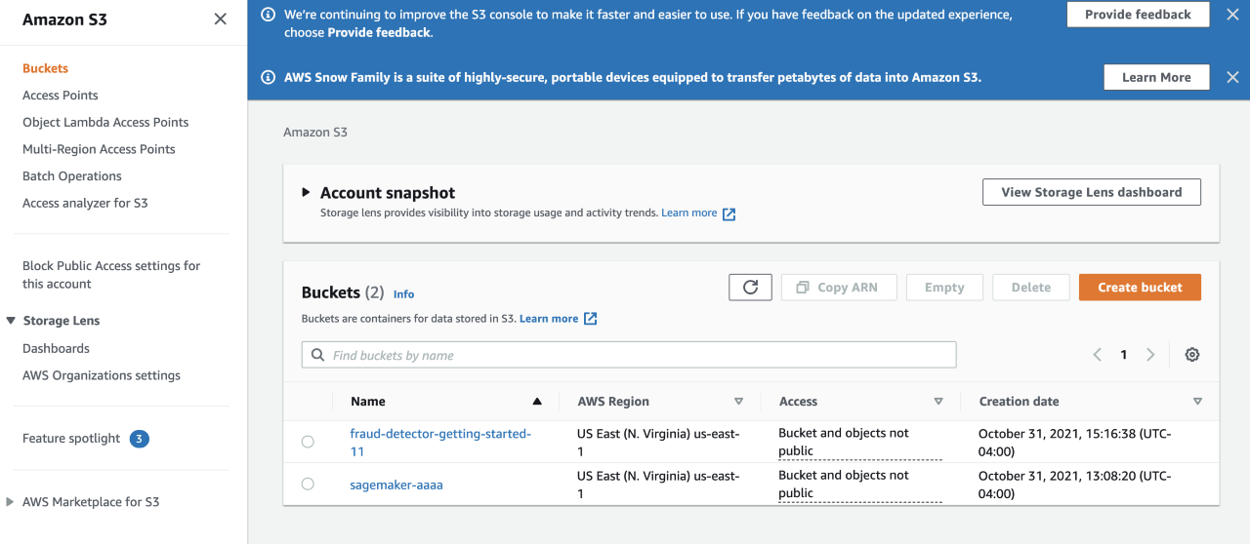
S3 Storage

Slide 22
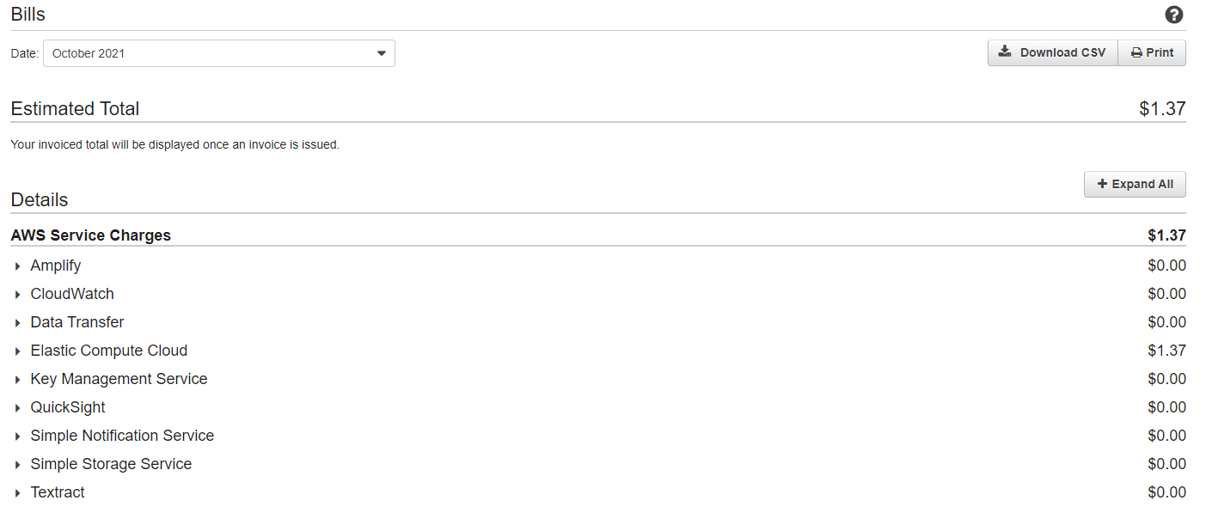
Cost & Billing

Slide 23
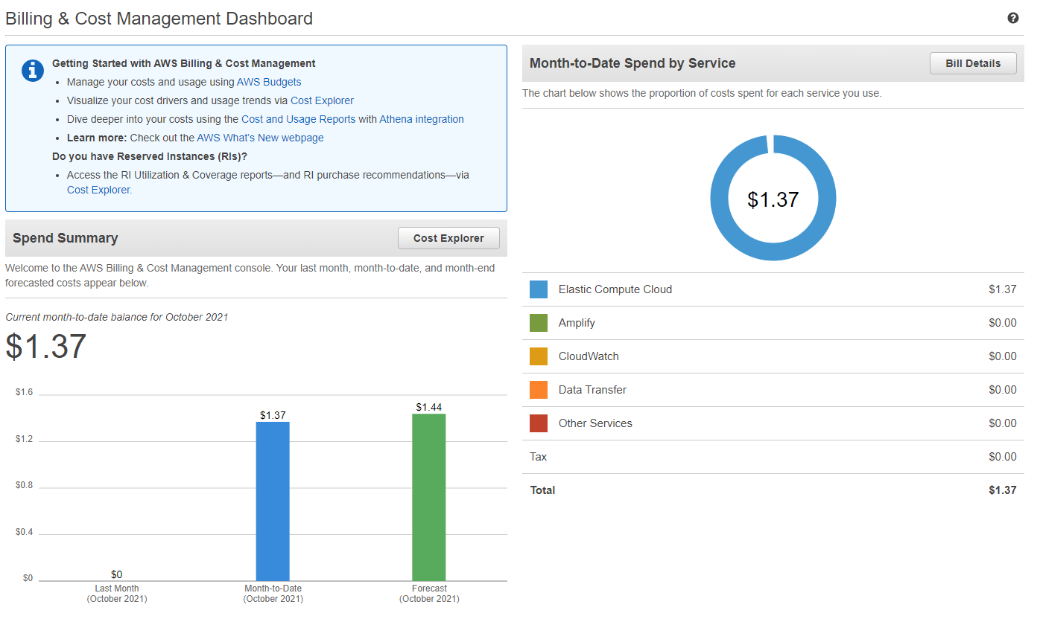
Cost & Billing

Slide 24
Conclusion
How many hours did it take you to finish the assignment?
3hrs
What was your project cost at the end?
1.37$
Name two pros of AWS (let’s say two things you like) and why?
Variety of Choice.
Cheap Price.
They have pretty much everything you want.
Name two cons of AWS (let’s say two things you don’t like) and why?
Some if the instructions are outdated.
I thought they would have bigger community. (When encountering issues, there are not a lot of solutions on Google).

